Slide 1

Security+
Exam SY0-601
Chapter 16
Cryptographic Concepts
Notes:
Gain Attention

Slide 2
Chapter 16 (Domain 2.8) Learning Objectives
Summarize the basics of cryptographic concepts.
Digital signatures
Key length
Key stretching
Salting
Hashing
Key exchange
Elliptic-curve cryptography
Perfect forward secrecy
Quantum
Communications
Computing
Post-quantum
Ephemeral
Modes of operation
Authenticated
Unauthenticated
Counter
Blockchain
Public ledgers
Cipher suites
Stream
block
Symmetric vs. asymmetric
Lightweight cryptography
Steganography
Audio
Video
Image
Homomorphic encryption
Common use cases
Low power devices
Low latency
High resiliency
Supporting confidentiality
Supporting integrity
Supporting obfuscation
Supporting authentication
Supporting non-repudiation
Limitations
Speed
Size
Weak keys
Time
Longevity
Predictability
Reuse
Entropy computational overheads
Resource vs security constraints

Slide 3
General Cryptographic Concepts
History:
Early ciphers were simple and easy to break
Caesar cipher (Roman Empire)
Enigma machine (WWII Germany)
Purple machine (WWII Japanese)
Use proven cryptographic libraries and number generators
Cryptographic algorithms should be tested by experts and public review
Plaintext is converted into ciphertext using an algorithm and key

Slide 4
Fundamental Methods
Modern cryptographic operations are performed using both an algorithm and a key.
The choice of algorithm depends on the type of cryptographic operation that is desired.
The subsequent choice of key is then tied to the specific algorithm.
Cryptographic operations include encryption for the protection of confidentiality, hashing for the protection of integrity, digital signatures to manage nonrepudiation, and a bevy of specialty operations such as key exchanges.

Slide 5
Fundamental Methods
Encryption operations are characterized by the quantity and type of data, as well as the level and type of protection sought.
Integrity protection operations are characterized by the level of assurance desired.
Data is characterized by its usage:
data in transit
data at rest
data in use.
It is also characterized in how it can be used, either in block form or stream form, as described next.

Slide 6
Digital Signatures
A digital signature is a cryptographic implementation designed to demonstrate authenticity and identity associated with a message.
Using public key cryptography, a digital signature allows traceability to the person signing the message through the use of their private key.
The addition of hash codes allows for the assurance of integrity of the message as well.
The operation of a digital signature is a combination of cryptographic elements to achieve a desired outcome.

Slide 7
Digital Signatures
The message to be signed is hashed, and the hash is encrypted using the sender’s private key. Upon receipt, the recipient can decrypt the hash using the sender’s public key.
If a subsequent hashing of the message reveals an identical value, two things are known:
First, the message has not been altered.
Second, the sender possessed the private key of the named sender and is therefore presumably the same person.

Slide 8
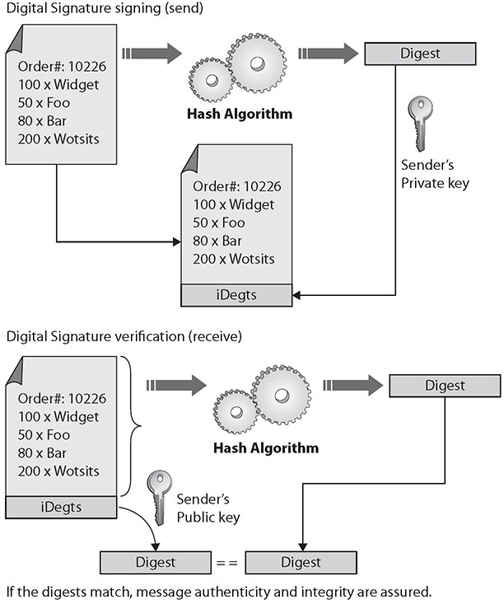
Digital Signatures

Slide 9
Digital Signatures
A digital signature does not by itself protect the contents of the message from interception.
The message is still sent in the clear, so if confidentiality of the message is a requirement, additional steps must be taken to secure the message from eavesdropping.
This can be done by encrypting the message itself, or by encrypting the channel over which it is transmitted.

Slide 10
Key Length
The strength of a cryptographic function typically depends upon the strength of a key, where a larger key has more entropy and adds more strength to the encryption.
Some algorithms have fixed key length; others are variable key lengths.
Some algorithms offer choices in key lengths: as a general rule, a longer key length is more secure, but also will take longer to compute.

Slide 11
Key Stretching
Key stretching is a mechanism that takes what would be weak keys and “stretches” them to make the system more secure against brute-force attacks.
Key stretching involves increasing the computational complexity by adding iterative rounds of computations—rounds that cannot be done in parallel.
When one wants to use a brute-force attack, the increase in computational workload becomes significant when done billions of times, making this form of attack much more expensive.
Two common key stretching algorithms:
Bcrypt
PBKDF2

Slide 12
Salting
The term salt refers to this initial data piece. Salts are particularly useful when the material being hashed is short, e.g. passwords.
Another term used in this regard is initialization vector, or IV, and this is used in several ciphers, particularly in the wireless space, to achieve randomness, even with normally deterministic inputs. IVs can add randomness and are used in block ciphers to initiate modes of operation.
A nonce is a number used only once, and is similar to a salt, or an IV.

Slide 13
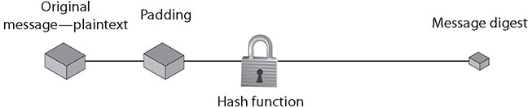
Hashing
A hashing function is a special mathematical function that performs one-way encryption, which means that once the algorithm is processed, there is no feasible way to use the ciphertext to retrieve the plaintext that was used to generate it.
Also, ideally, there is no feasible way to generate two different plaintexts that compute to the same hash value.

Slide 14
Hashing
Common uses of hashing algorithms are to store computer passwords and to ensure message integrity.
You could hash a message to get a message authentication code (MAC), and the computational number of the message would show that no intermediary has modified the message.
HMAC, or Hash-based Message Authentication Code, is a special subset of hashing technology. It is a hash algorithm applied to a message to make a MAC, but it is done with a previously shared secret key. So, the HMAC can provide integrity simultaneously with authentication.

Slide 15
Hashing
A hash algorithm can be compromised with what is called a collision attack, in which an attacker finds two different messages that hash to the same value.
This type of attack is very difficult and requires generating a separate algorithm that will attempt to find a text that will hash to the same value of a known hash.
The consequence of a hash function that suffers from collisions is that integrity is lost.
Popular hash algorithms:
SHA series, RIPEMD algorithms, and MD series

Slide 16
Key Exchange
Key exchange is the central foundational element of a secure symmetric encryption system.
Maintaining the secrecy of the symmetric key is the basis of secret communications.
In asymmetric systems, the key exchange problem is one of key publication. Because public keys are designed to be shared, the problem is reversed from one of secrecy to one of publicity.
The Diffie-Hellman key exchange depends on two random numbers, each chosen by one of the parties and kept secret. Diffie-Hellman key exchanges can be performed in-band, and even under external observation, as the secret random numbers are never exposed to outside parties.

Slide 17
Elliptic Curve Cryptography
Elliptic curve cryptography (ECC) works on the basis of elliptic curves. An elliptic curve is a simple function that is drawn as a gently looping curve on the X,Y plane.
Equation: y2 = x3 + ax2 + b
Elliptic curves work because they have a special property—you can add two points on the curve together and get a third point on the curve.
For cryptography, the elliptic curve works as a public key algorithm.
Users agree on an elliptic curve and a fixed curve point. This information is not a shared secret, and these points can be made public without compromising the security of the system.

Slide 18
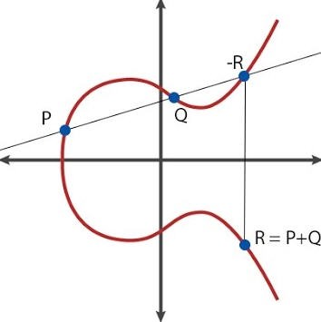
Elliptic Curve Cryptography

Slide 19
Perfect Forward Secrecy
Perfect Forward Secrecy (PFS) is a property of a public key system in which a key derived from another key is not compromised, even if the originating key is compromised in the future.
This is especially important in session key generation, where future communication sessions may become compromised; if perfect forward secrecy were not in place, then past messages that had been recorded could be decrypted.

Slide 20
Quantum Cryptography
Quantum cryptography is the use of quantum computing hardware to perform encryption and decryption processes.
Quantum hardware is still in its early stages of development, and the immense computing power in these platforms will revolutionize cryptography.
Quantum principles have already been deployed into communication-related key exchanges through quantum key distribution (QKD).
QKD does not actually encrypt communication but rather provides a means for users to securely distribute keys that are used for encrypting the communication channel.

Slide 21
Quantum Cryptography
Quantum computers use a new structure called qubits, which allow information to be represented differently than just “on” or “off” as binary bits do.
Qubits enable multiple paths of a problem to be computed simultaneously.

Slide 22
Post-Quantum Era
As quantum computing presents a challenge for many of today’s cryptographic algorithms, significantly reducing their strength, there is a movement to develop algorithms that are not easily solved via quantum methods.
This is not a theoretical exercise, as government agencies and others have been working on practical solutions to have answers and substitute algorithms should any existing algorithm fail, whether by quantum computing or other problem.

Slide 23
Ephemeral Key
Ephemeral keys are cryptographic keys that are used only once after generation.
When an ephemeral key is used as part of the Diffie-Hellman scheme, it forms an Ephemeral Diffie-Hellman (EDH) key exchange.
An EDH generates a temporary key for each connection, never using the same key twice.
This provides for perfect forward secrecy. If this is constructed using an elliptic curve algorithm, it would be ECDHE, for Elliptic Curve Diffie-Helman Ephemeral, as mentioned previously.

Slide 24
Modes of Operations
In symmetric or block algorithms, there is a need to deal with multiple blocks of identical data to prevent multiple blocks of ciphertext that would identify the blocks of identical input data.
There are multiple methods of dealing with this, called modes of operation.
The basic premise is to use some source of entropy before encrypting subsequent blocks so that identical blocks of plaintext produce differing blocks of ciphertext.
These modes can be broken into three groups: authenticated, unauthenticated, and counter.

Slide 25
Authenticated
Authenticated Encryption with Associated Data (AEAD) is a form of encryption designed to provide both confidentiality and authenticity services.
A wide range of authenticated modes is available for developers, including GCM, OCB, and EAX.

Slide 26
Counter
Counter mode (CTM) uses a “counter” function to generate a nonce that is used for each block encryption.
Different blocks have different nonces, enabling parallelization of processing and substantial speed improvements.
The sequence of operations is to take the counter function value (nonce), encrypt it using the key, then XOR it with plaintext.
Each block can be done independently, resulting in the ability to multithread the processing.
CTM is also abbreviated as CTR.

Slide 27
Counter
CCM is a mode of operation involving CBC (cipher block chaining, described in the next section) with a MAC, or CBC-MAC.
This method was designed for block ciphers with a length of 128 bits, where the length of the message and any associated data must be known in advance.
This means it is not an “online” form of AEAD, which is characterized as allowing any length of input.

Slide 28
Counter
Galois Counter Mode (GCM) is an extension of CTM in that there’s an addition of a Galois mode of authentication.
This adds an authentication function to the cipher mode, and the Galois field used in the process can be parallelized, providing efficient operations.
GCM is employed in many international standards, including IEEE 802.1ad and 802.1AE.
NIST has recognized AES-GCM as well as GCM and GMAC. AES GCM cipher suites for TLS are described in IETF RFC 5288.

Slide 29
Unauthenticated
Unauthenticated modes use a non-identity-based source for the entropy element for subsequent blocks.
In cipher block chaining (CBC), each block is XORed with the previous ciphertext block before being encrypted.
To obfuscate the first block, an initialization vector (IV) is XORed with the first block before encryption.
CBC is one of the most common modes used, but it has two major weaknesses.
First, because there is a dependence on previous blocks, the algorithm cannot be parallelized for speed and efficiency.
Second, because of the nature of the chaining, a plaintext block can be recovered from two adjacent blocks of ciphertext.

Slide 30
Blockchain
Blockchains are lists of records, where each addition to the list is done by a cryptographic algorithm.
Records in a blockchain are resistant to modification.
This permits a distributed ledger that can record transactions and have both verification of additions and protection with respect to integrity.
The strength of the integrity comes from both the signing of records and the distributed nature of the blockchain.

Slide 31
Blockchain
The concept of blockchains was invented to create the public transaction ledger of cryptocurrencies.
A cryptocurrency is a currency system built on a finite set of “rare” numbers that are mined and then “created.”
As there is no central authority, numbers when mined are entered into the distributed ledger, marking their creation.
All transactions are also entered into the ledger, preventing double-spending of the tokens.
The use of the distributed public ledger provides the protections that physical tokens provide—only one person can control a given currency token at any given time, and all transactions are immutable.

Slide 32
Blockchain
The term cipher suite refers to a set of algorithms used together in cryptography, with the most famous being the TLS cipher suite.
The cipher suite will list the key exchange mechanism, the authentication protocol, the block/stream cipher, and message authentication.
Block:
Block ciphers operate on input data in a series of blocks.
Stream:
Stream operations typically take place on a single byte at a time, using an XOR function and a pseudorandom key.

Slide 33
Symmetric vs Asymmetric
Both symmetric and asymmetric encryption methods have their advantages and disadvantages.
Symmetric encryption tends to be faster, is less computationally involved, and is better for bulk transfers. But it suffers from a key management problem in that keys must be protected from unauthorized parties.
Asymmetric methods resolve the key secrecy issue with public keys, but they add significant computational complexity, which makes them less suited for bulk encryption.
Bulk encryption can be done using the best of both systems, by using asymmetric encryption to pass a symmetric key. By adding in ephemeral key exchange, you can achieve perfect forward secrecy

Slide 34
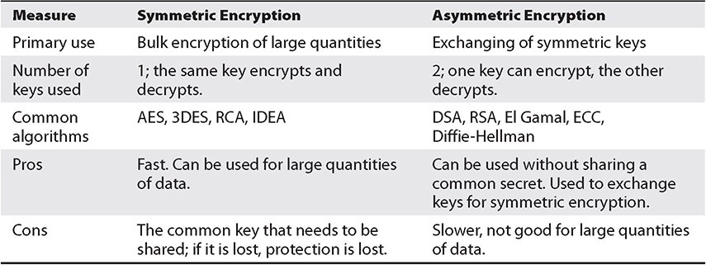
Symmetric vs Asymmetric

Slide 35
Lightweight Cryptography
In the IOT world, small devices do not have large computing power; compute-resource-constrained devices.
Lightweight cryptography is a specialized suite of cryptographic algorithms designed to operate in this resource-constrained environment.
Entire suites of lightweight algorithms designed for 8-bit processors have been developed, including hash functions, block and stream ciphers, and even asymmetric and signing functions.

Slide 36
Steganography
Steganography, an offshoot of cryptography technology, gets its meaning from the Greek word steganos, meaning covered.
Hiding data within data.
The most common application is the concealing of a text message in a picture file.
The advantage to steganography over cryptography is that the messages do not attract attention, and this difficulty in detecting the hidden message provides an additional barrier to analysis.
The most common method is LSB (least significant bit) encoding.

Slide 37
Homomorphic Encryption
One of the primary purposes of cryptography is to prevent unauthorized access to data.
This is important for data at rest and data in transit, but it can be an issue for data in use.
Homomorphic encryption is a set of algorithms that allows operations to be conducted on encrypted data, without decrypting and re-encrypting.
The concept is simple: create a system that allows operations on ciphertext that, when decrypted, will have the same result as if the operation was performed on plaintext.
Mostly works with numbers/integers involved in addition.

Slide 38
Common Use Cases
Cryptographic services are being employed in more and more systems, and many common use cases are associated with them.
Examples include implementations to support situations such as low power, low latency, and high resiliency, as well as supporting functions such as confidentiality, integrity, and nonrepudiation.

Slide 39
Common Use Cases
Low-Power Devices
Low-Latency Operations
High-Resiliency Systems
Support for Confidentiality
Support for Integrity
Support for Obfuscation
Supporting Authentication
Support for Nonrepudiation

Slide 40
Limitations
Speed
Size
Weak Keys
Time
Longevity
Predictability
Reuse
Entropy
Computational Overhead
Resource vs. Security Constraints
Weak/Deprecated Algorithms

